Slide 1
PAWSOME A Perfect place for Dog Adoption And Care
Group Members –Rushikesh Jadhav(220343120039)
Rahul Zunjar(220343120088)
Prachi Sonone(220343120105)
Shrinivas Vader(220343120111)
Project Guide- Mrs. Harshita Maheshwari

Slide 2
Contents
Introduction
Choice of topic
Proposed System
Methodology
Proposed System Model
Proposed Approach
Screenshot
System Requirements
Applications
Advantages and Limitations
Conclusion
Future Scope
References

Slide 3
Introduction
A web-based application for users to have easier and better access to Adoption and care for dog
The website is accessible for users and administrator where
Users can access to the system to view the list of dogs waiting to be adopted along with their details such as age, gender, breed and their description
Administrator are the main authority of the system and they are responsible for adding, deleting, editing, reviewing that information if necessary

Slide 4
Choice of topic
Solves a realistic problem
Lack of such platform in our country
Features were practically attainable
Overall idea was interesting to work on

Slide 5
Proposed System
AIM
Get help for dogs to better life
To provide an online platform for those people who want to adopt dogs
Proposed System
Digital Platform for adoption and care for dog
Doctors are also available for dog care
Tips and Tricks for owner to take care of their pet dog

Slide 6
Methodology
The objective is to create a website that can perform the following
Connecting to an HTTPS site through GPRS/WIFI.
Opening the relevant HTML page using HTTPS POST & GET methods.
Read the data logically into admin, user and doctor.
Creating a local database.

Slide 7
Proposed System Model
There are there main modules:
Admin User Login Doctor Login
Home
Add/Delete Dog
Add/Delete Community
Add/Delete User
Log Out
Home
Add Dog
Adopt Dog
Create/Join Community
Care Facility
Dog hostel facility
Log Out
Home
Appointment
Log Out

Slide 8
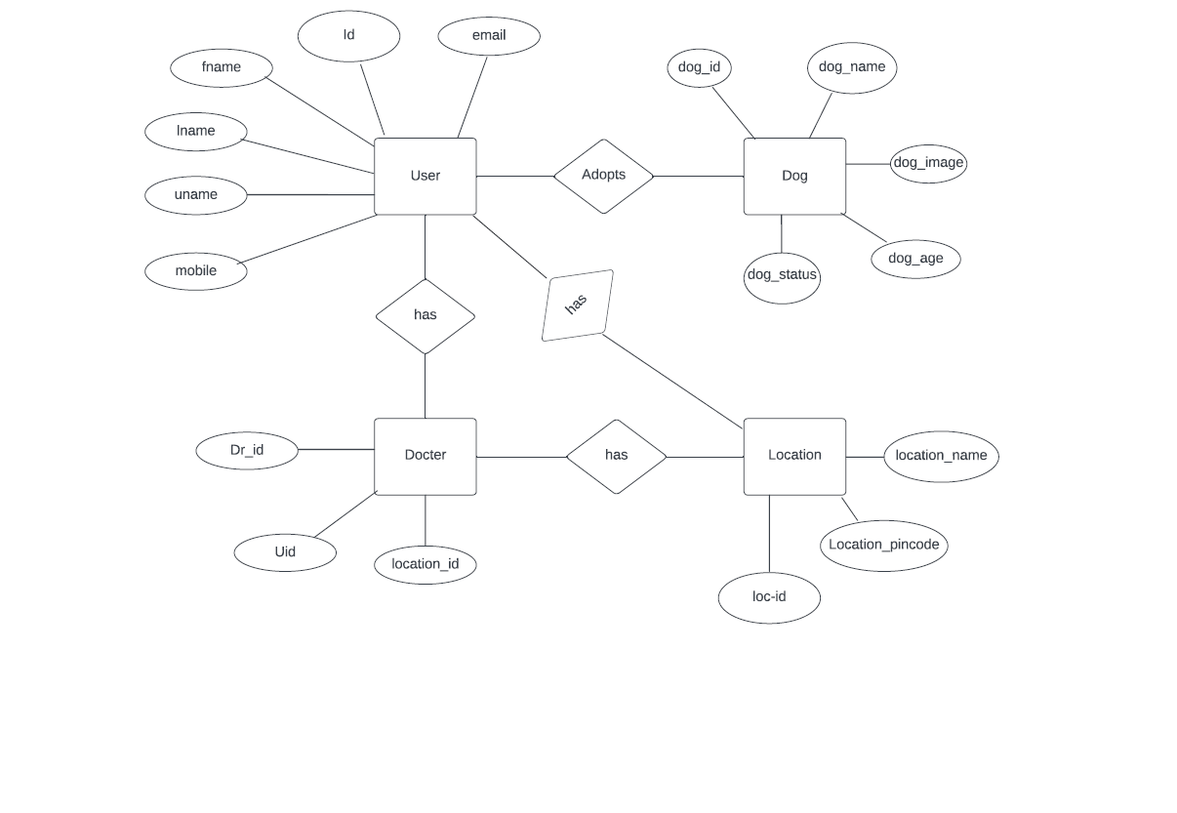
Proposed Approach

Slide 9
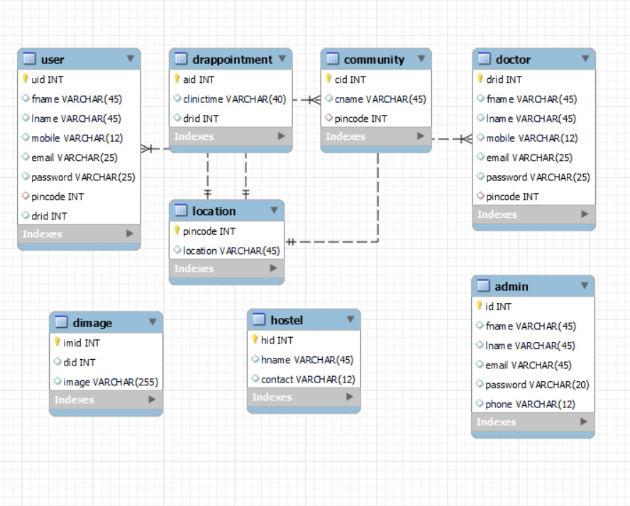

Slide 10
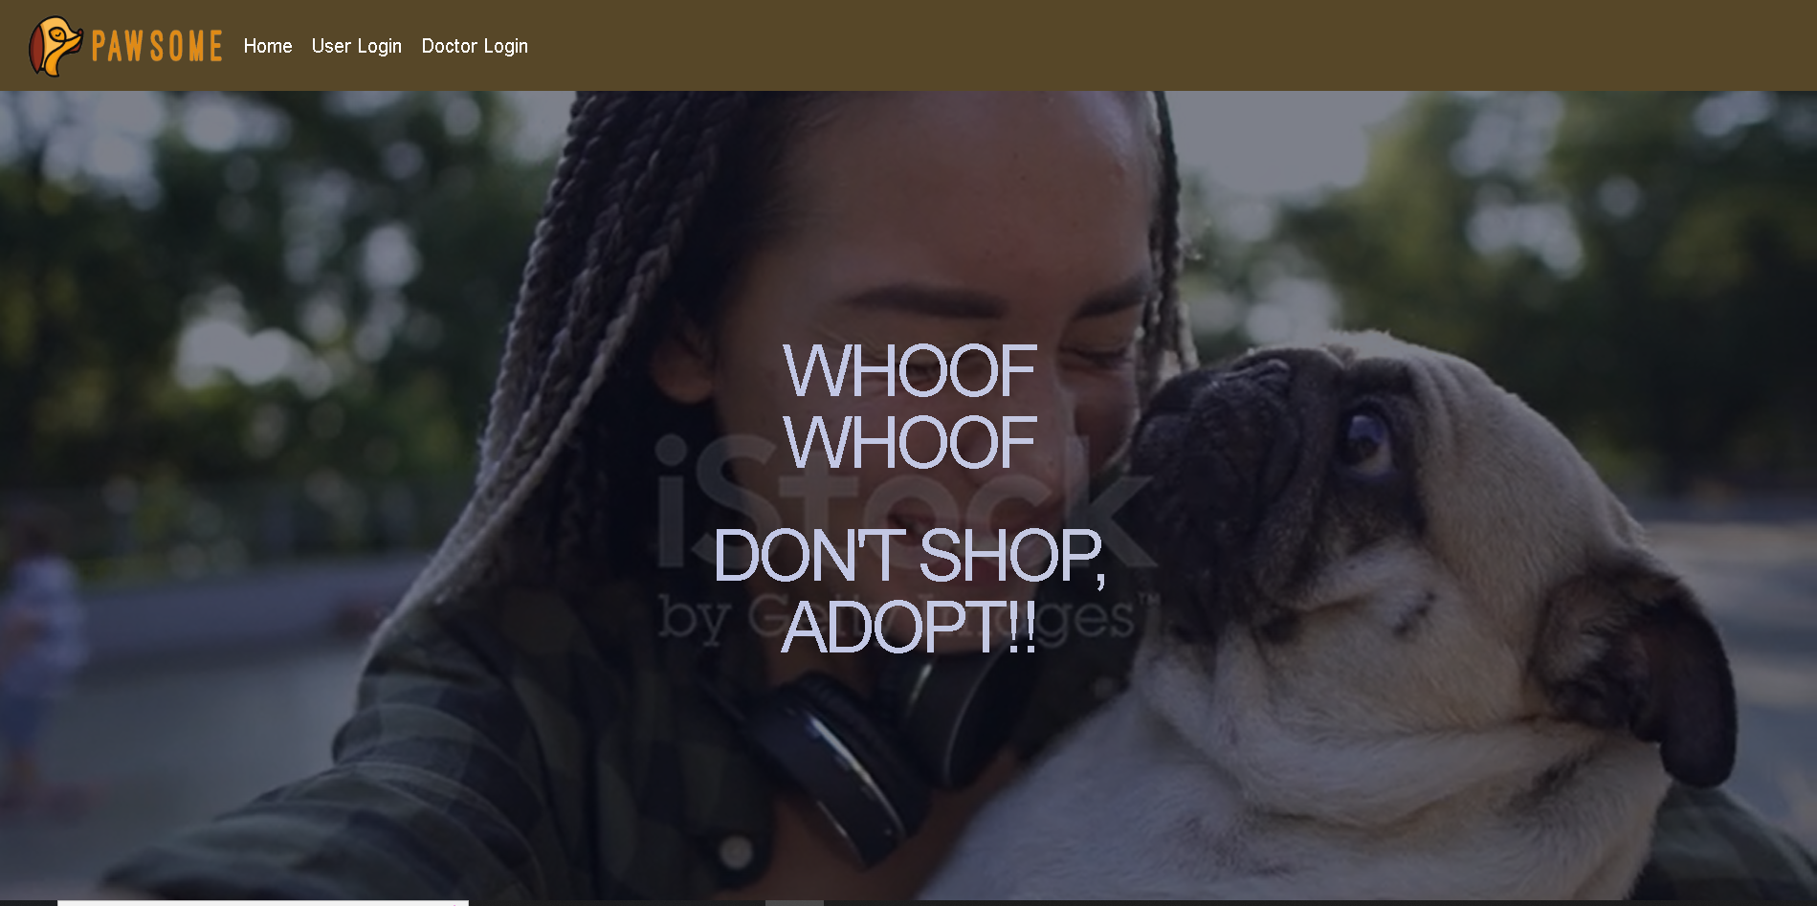
Screenshots

Slide 11
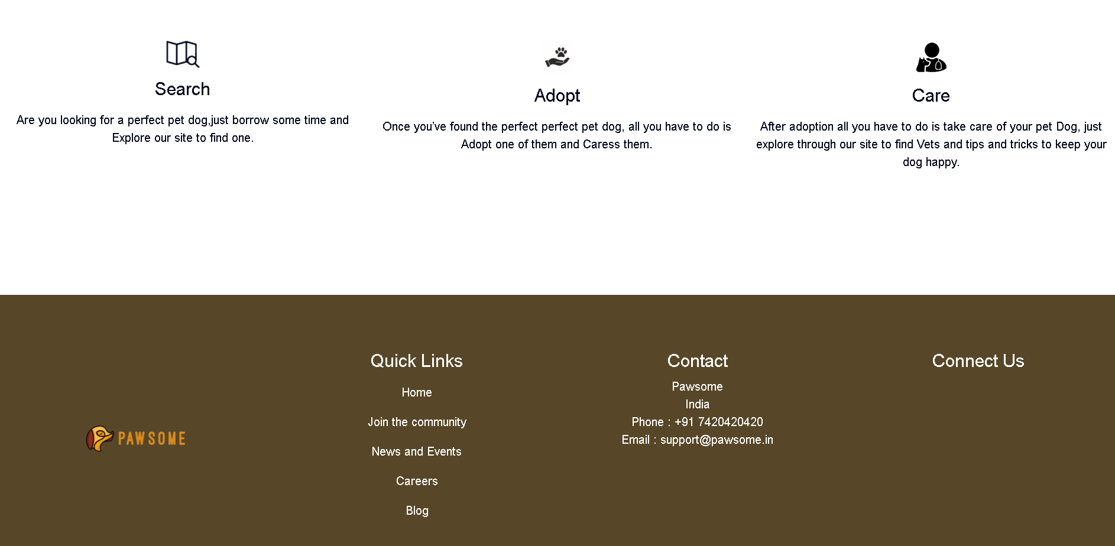

Slide 12
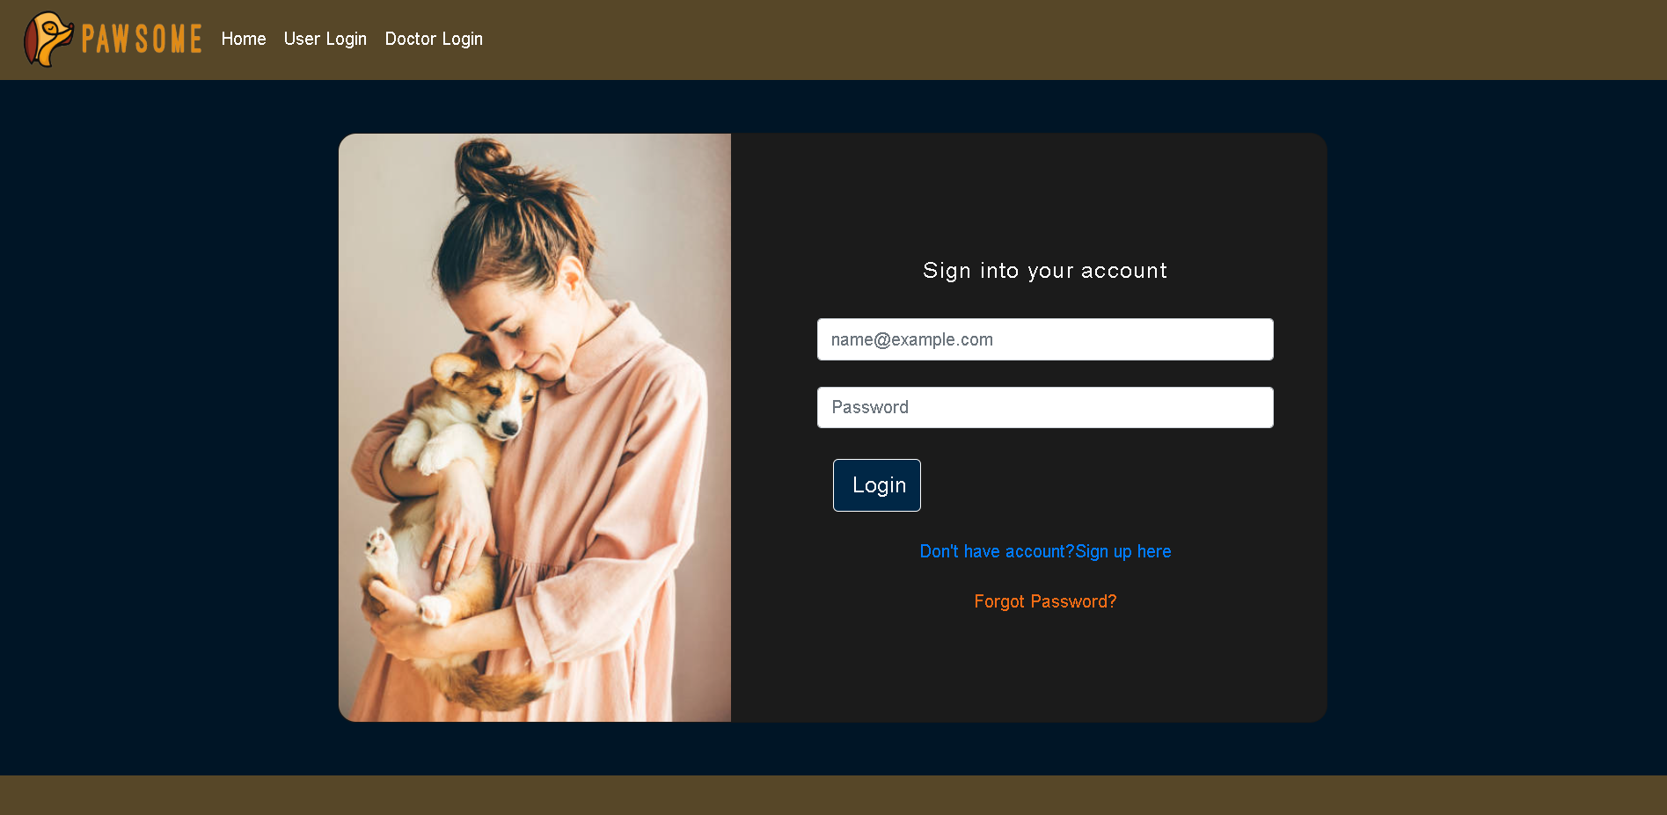

Slide 13
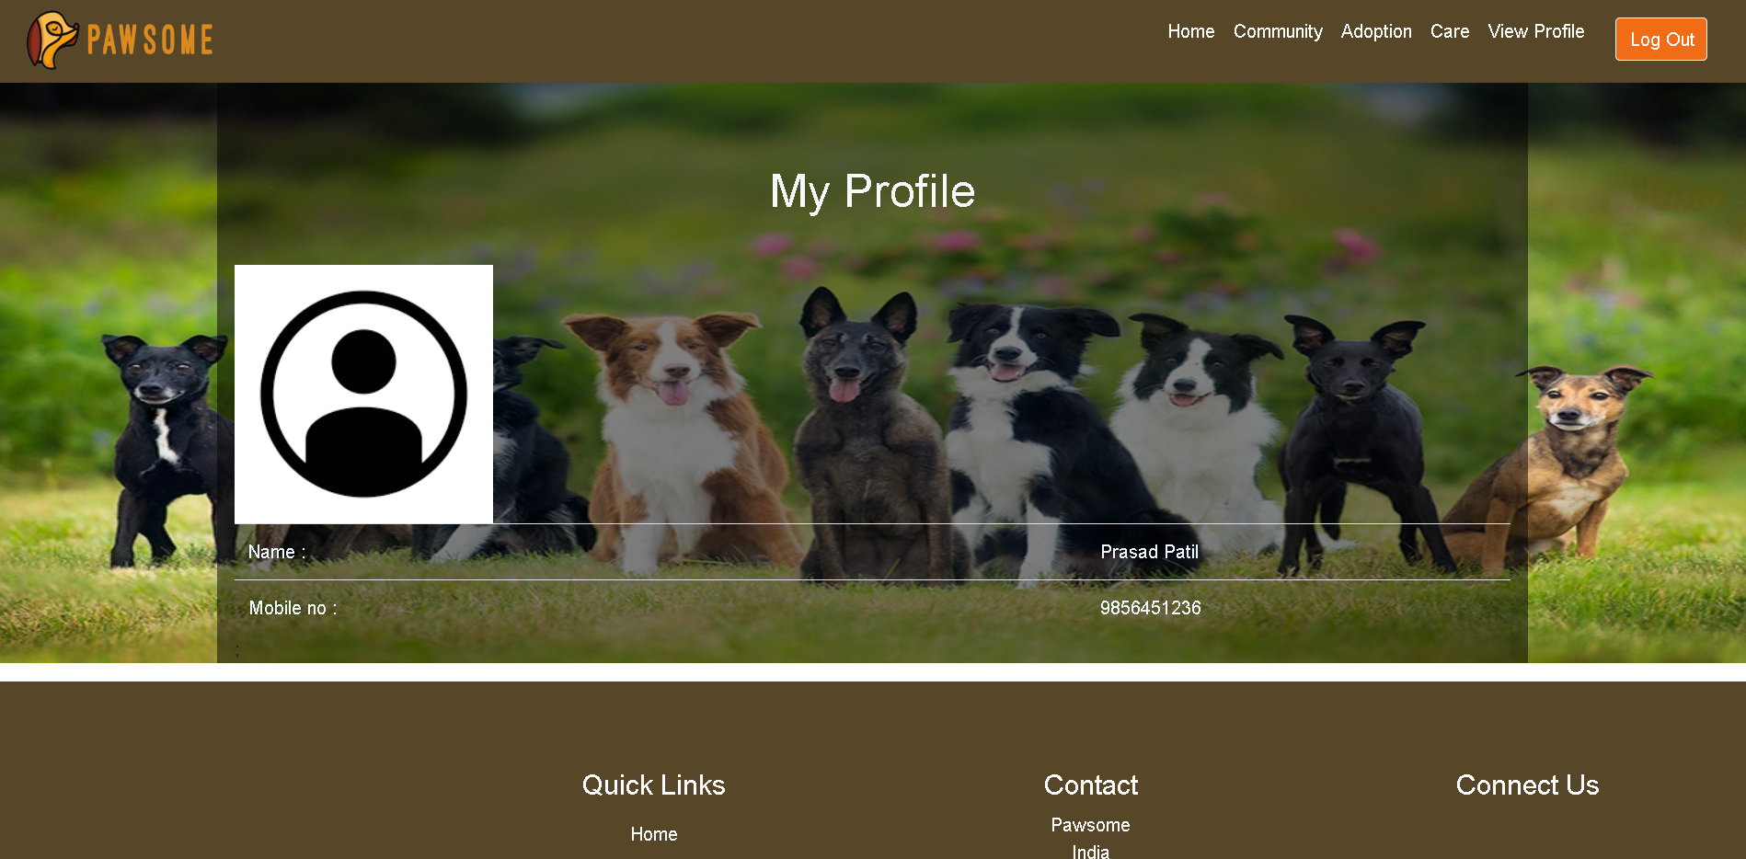

Slide 14
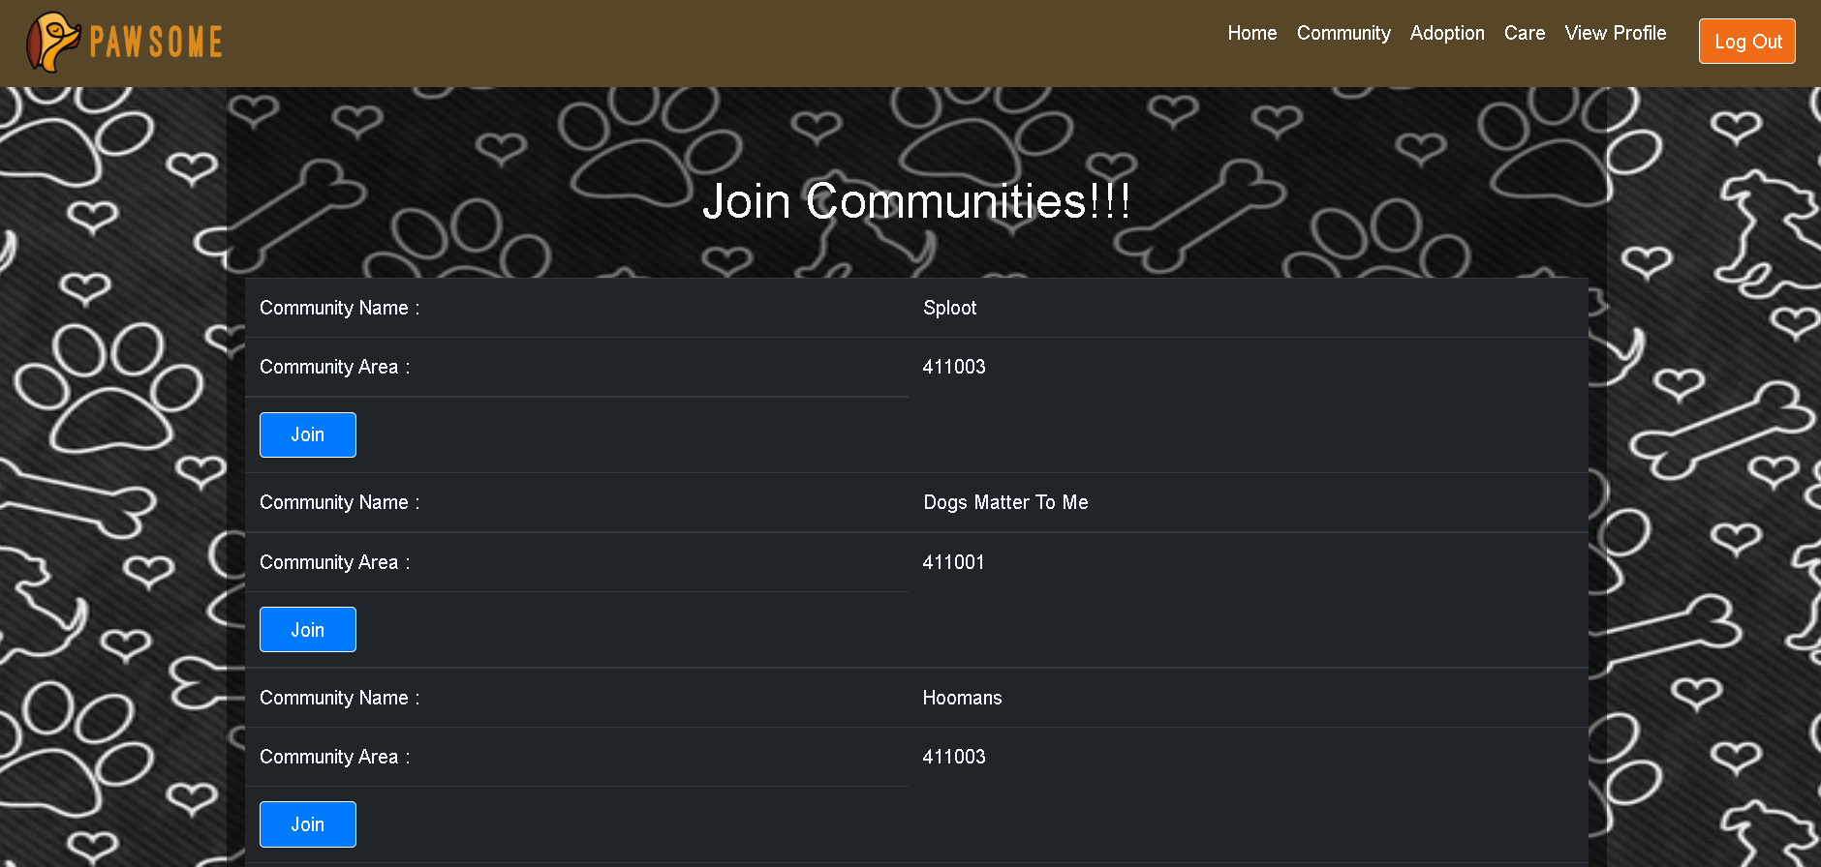

Slide 15
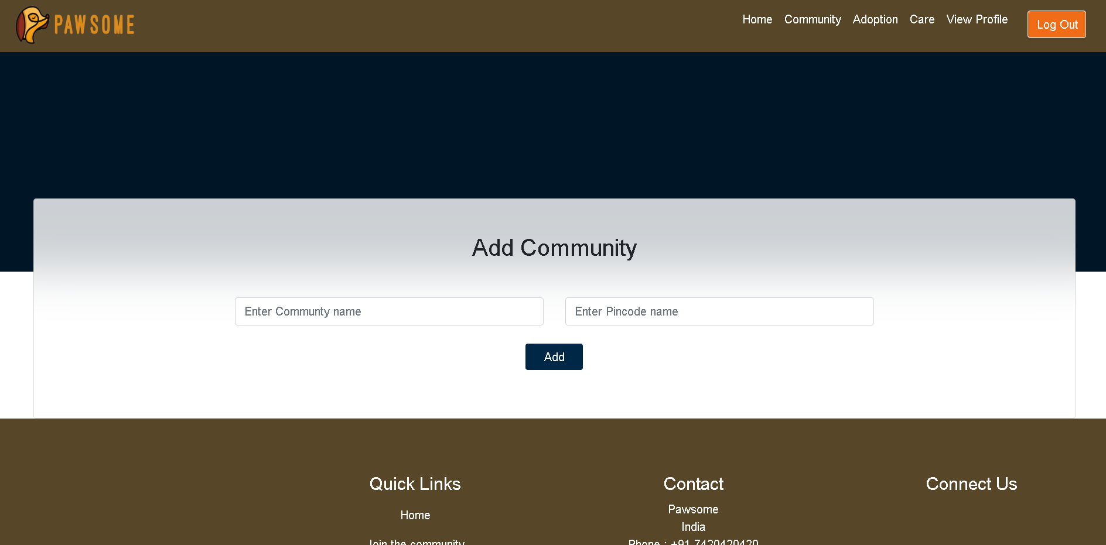

Slide 16
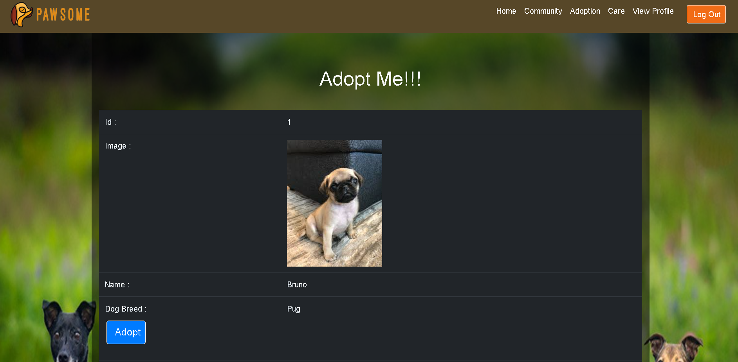

Slide 17
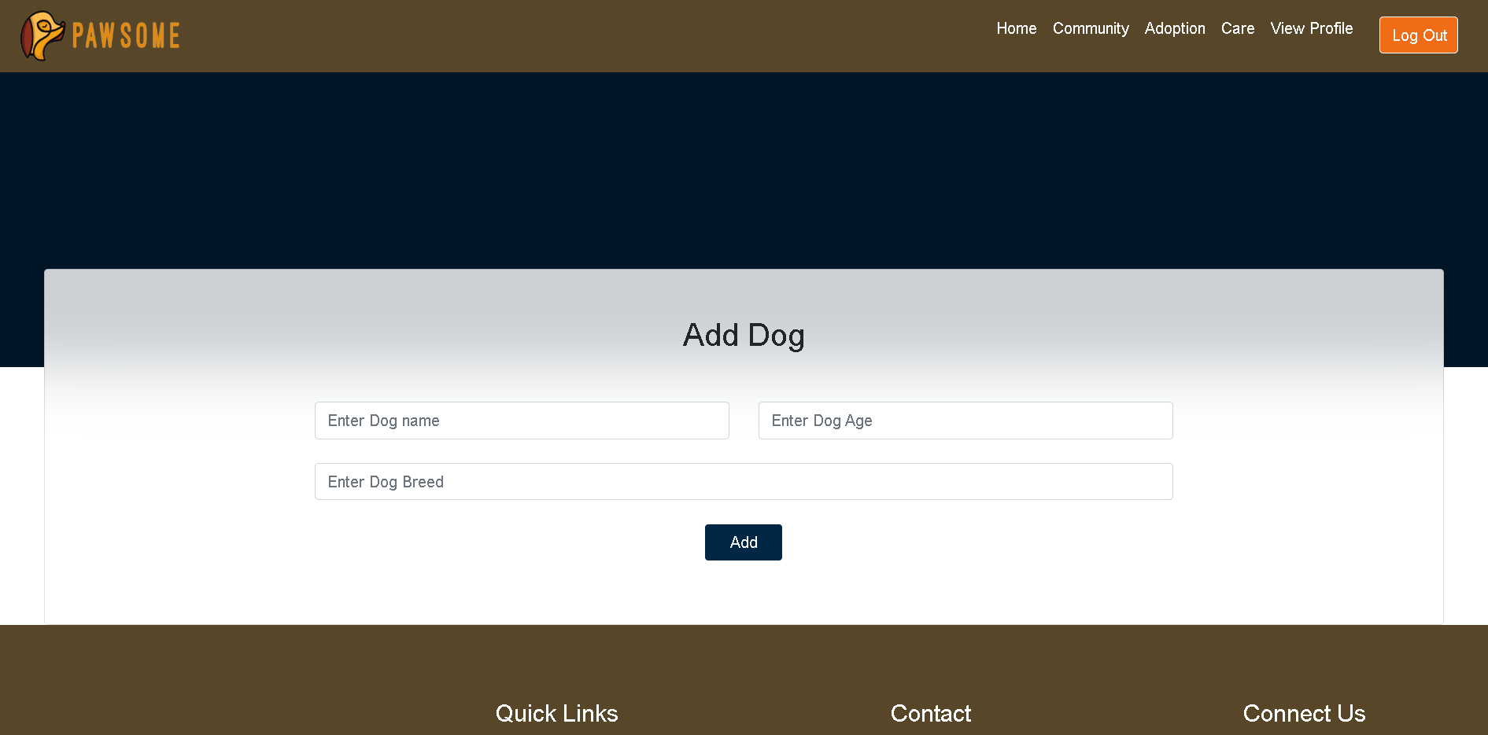

Slide 18
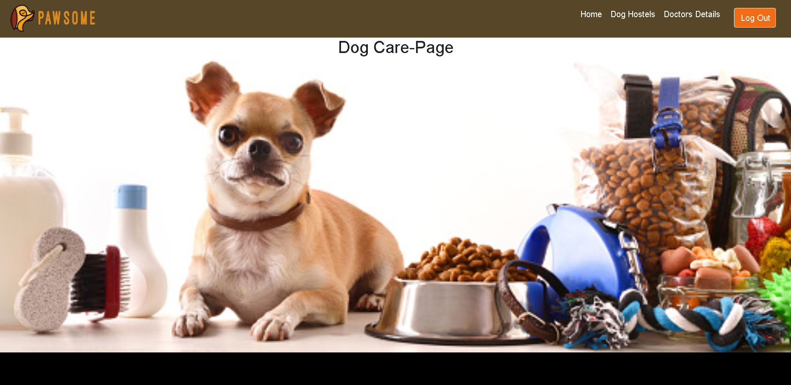

Slide 19
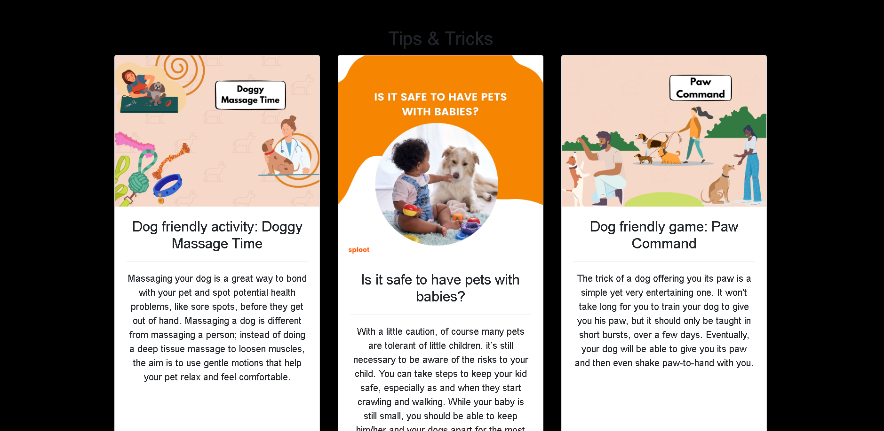

Slide 20
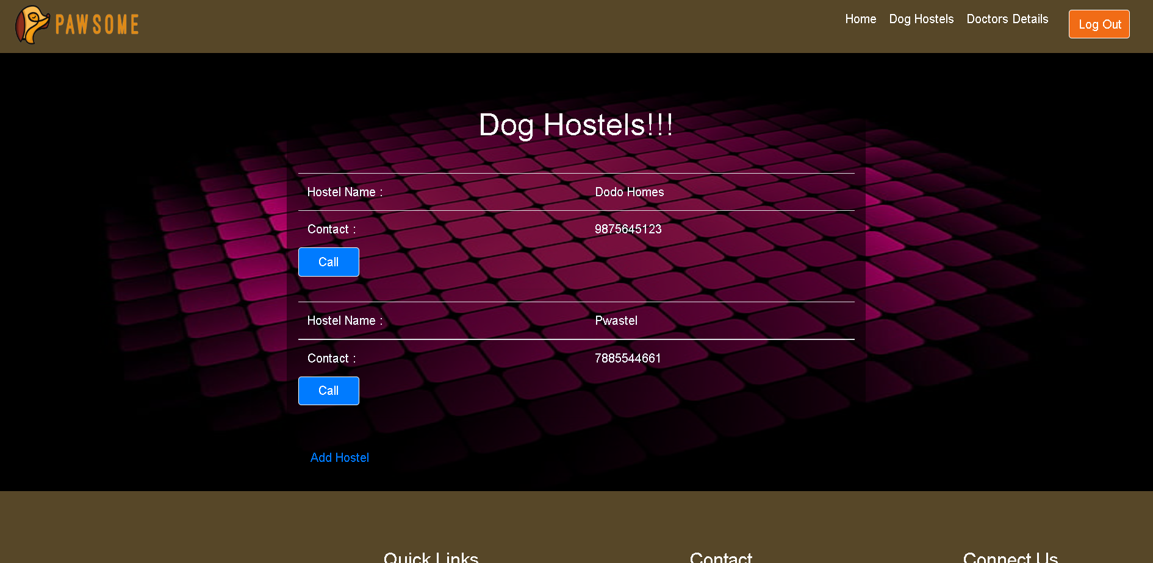

Slide 21
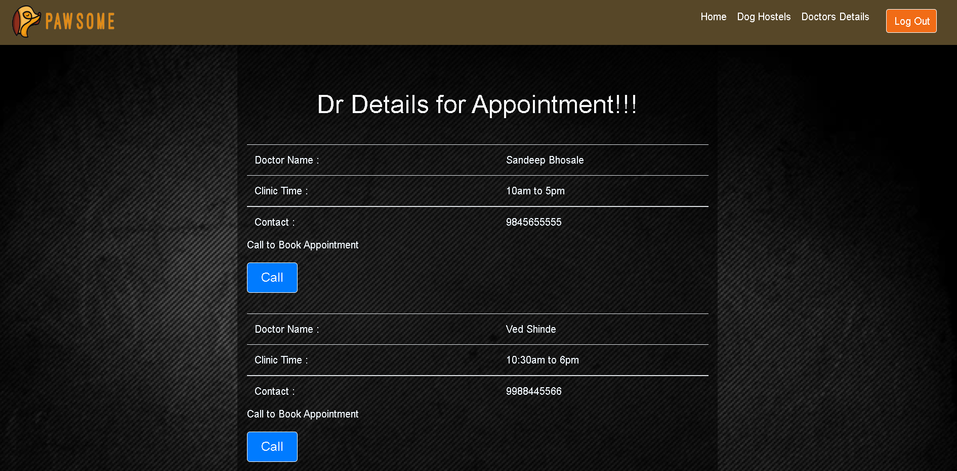

Slide 22
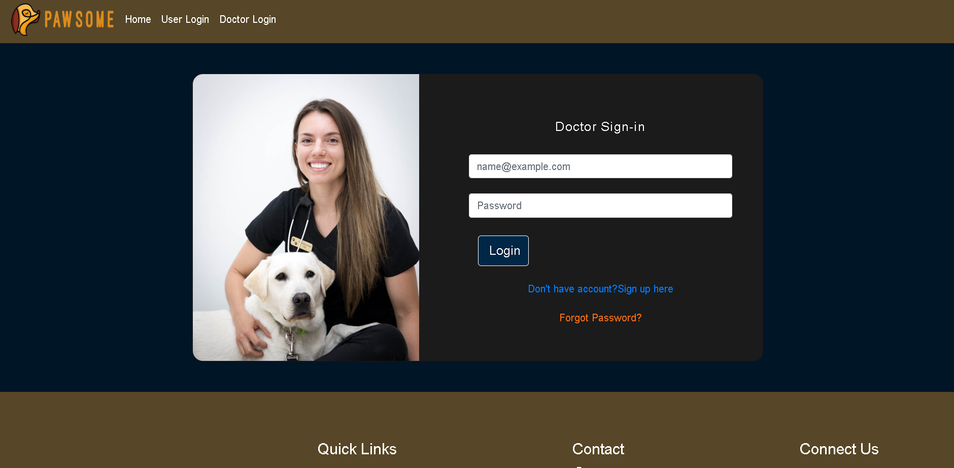

Slide 23
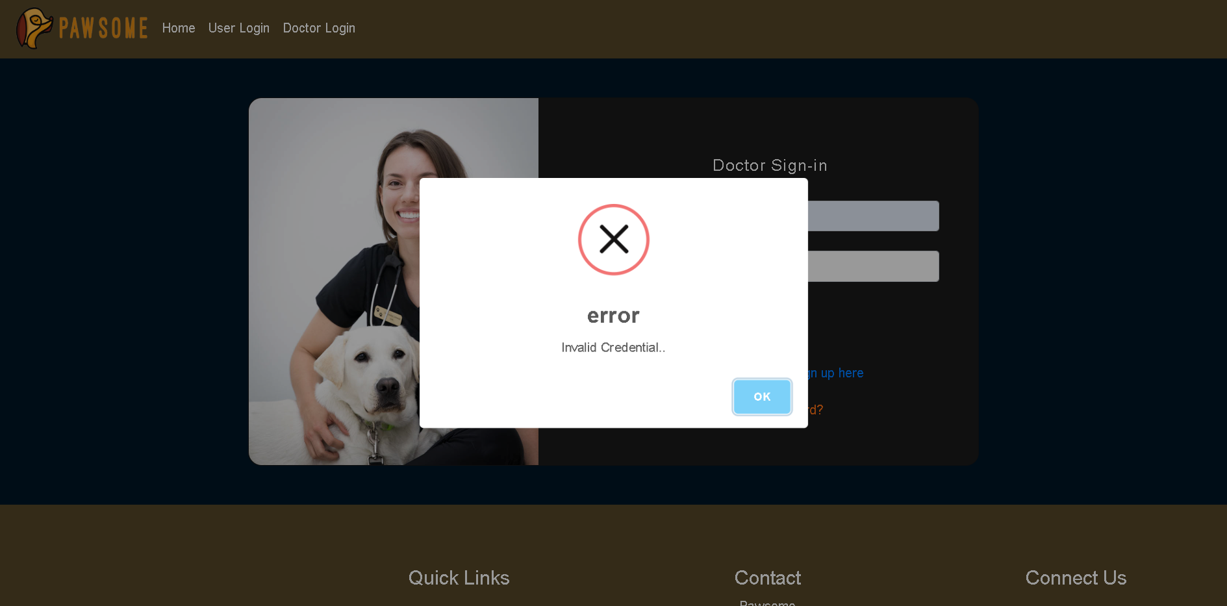

Slide 24
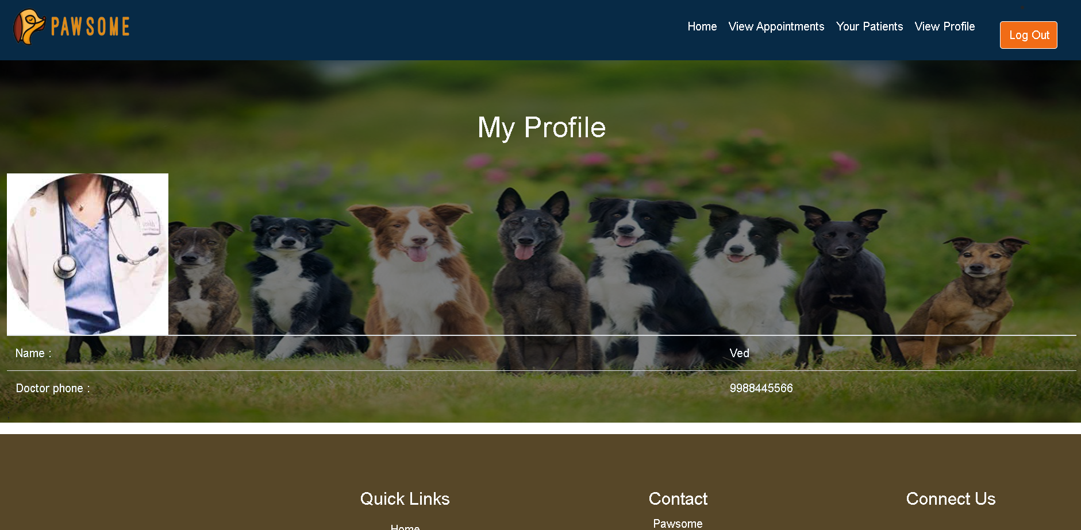

Slide 25
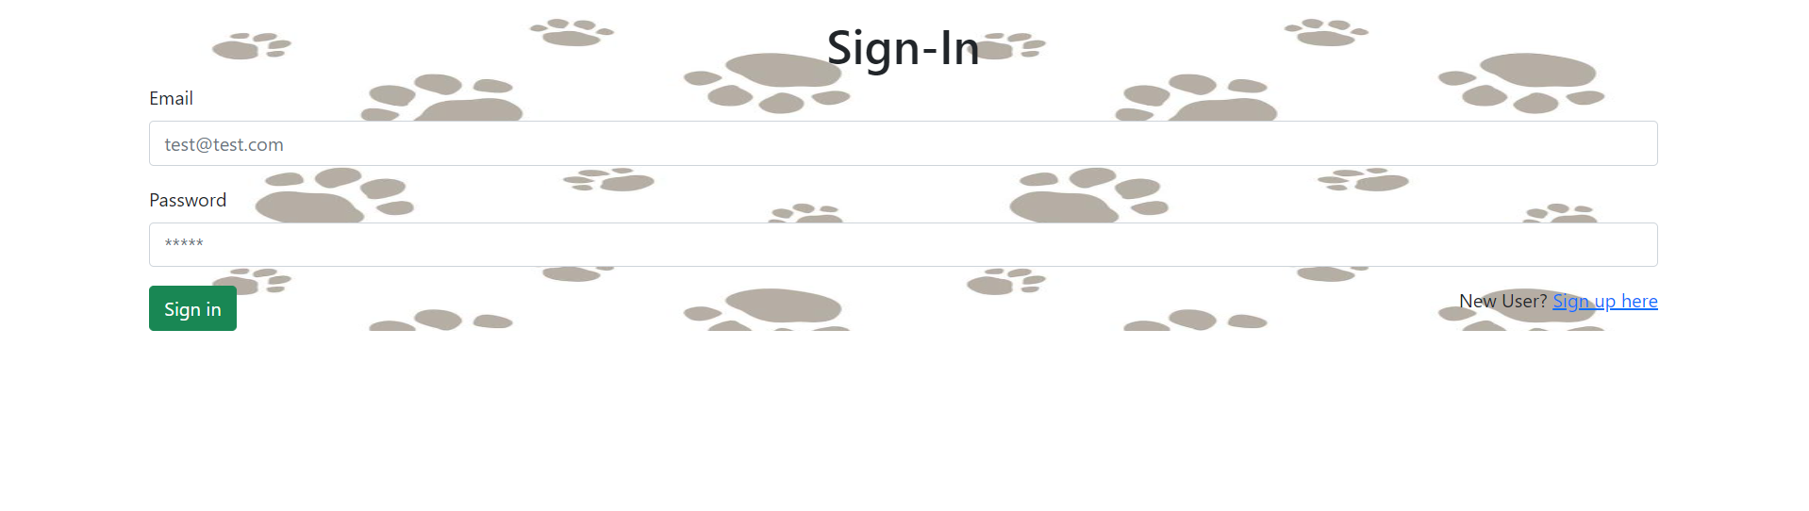
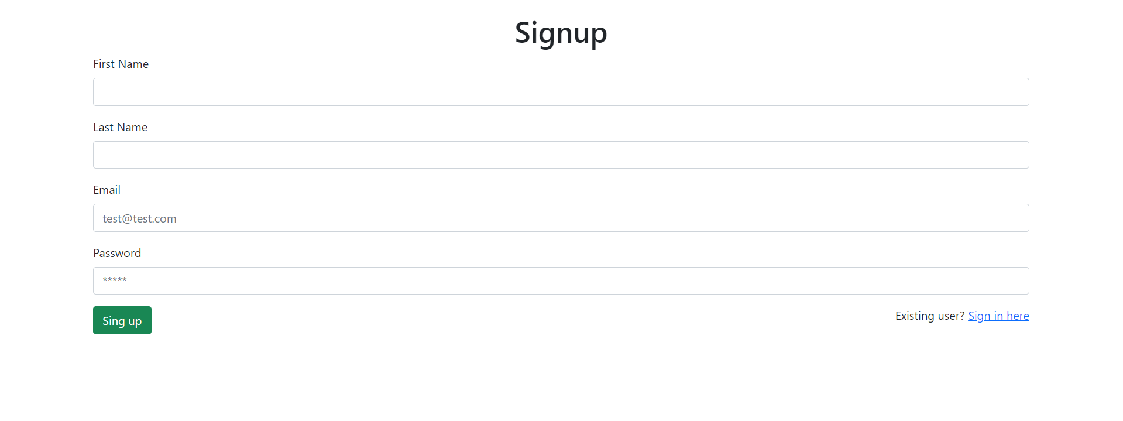

Slide 26
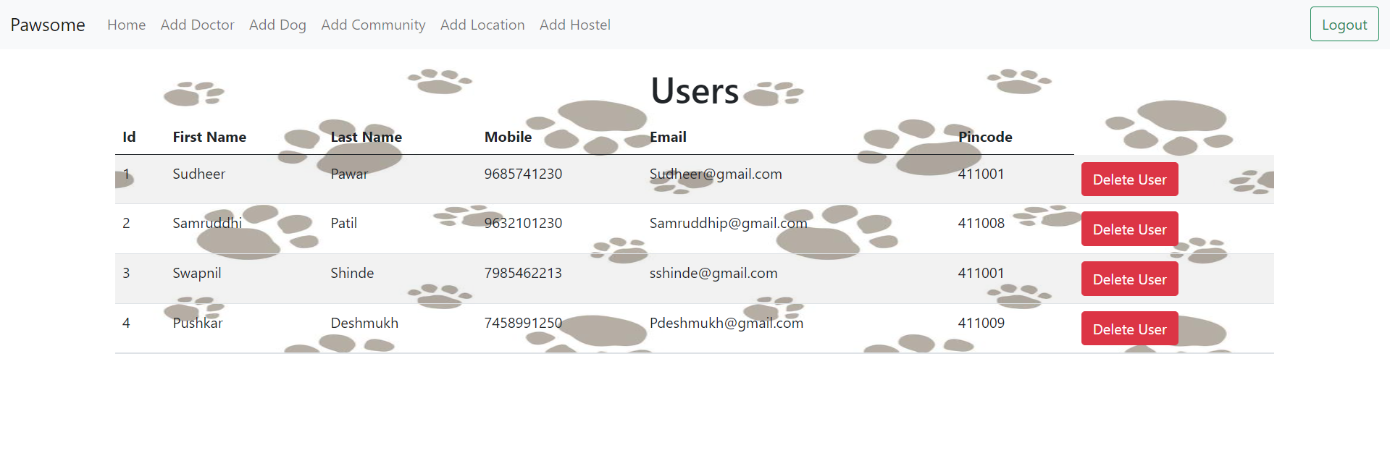

Slide 27
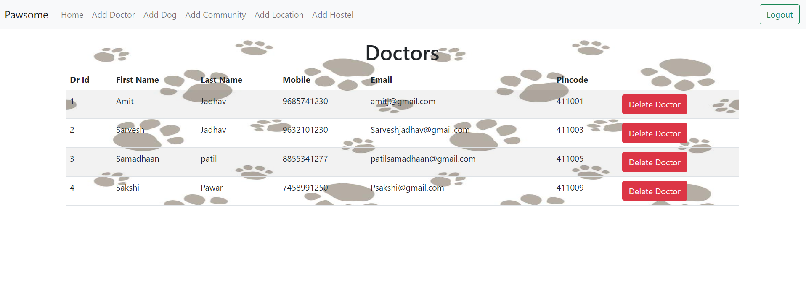
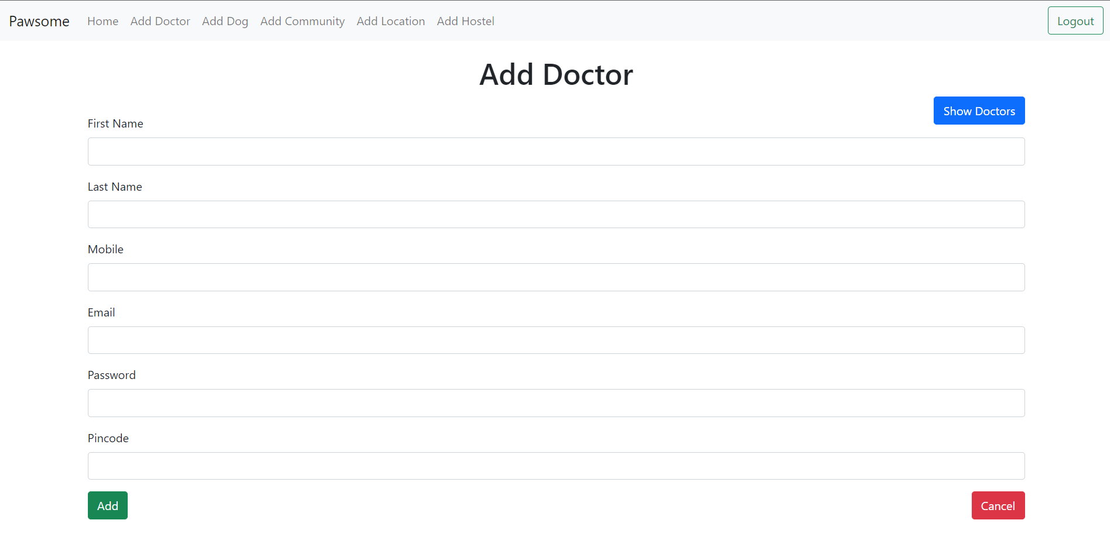

Slide 28
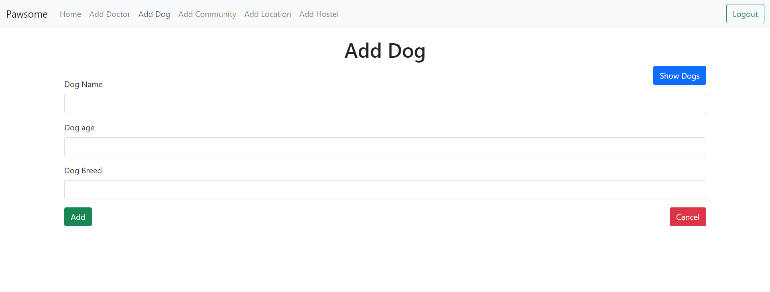
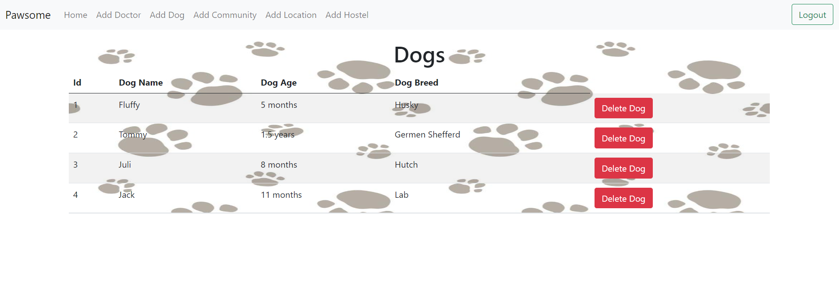

Slide 29
System Requirements
Software Requirements
Windows
Tomcat server
STS, MySQL
Hardware Requirements
Processor- i3
Hard Disk- 5GB
Memory- 4GB RAM

Slide 30
Technologies Used
React JS for UI of application
Spring boot for User portal backend
Express JS for admin portal backend
MySQL for database

Slide 31
Applications
NGO
Community
Adoption and care of dogs
Can be used by Veterinary Doctors

Slide 32
Advantages
Provide better life for dogs
User-friendly, time saving
Better place for dog adoption

Slide 33
Limitations
It requires an extensive database and memory.
If backend server fails then whole project will not work.
It requires precise user details and doctor details.

Slide 34
Conclusion
Thus we have implemented a digital platform using web programming technologies for adoption and care of dogs.
This system will support to encourage positive human-dog interactions
Using this platform users will get care facility provide details of available dog hostels.
This web application also provide doctor details so that user can communicate to doctors for their dogs, so that this system will be helpful and time saving.

Slide 35
Future Scope
Donation option for some financial help to NGO
Volunteer module to participate volunteers to help the stray animals
Use for homeless animals

Slide 36
References
Mr. Saleel Bagde for Database.
Mrs. Harshita Maheshwari for React JS and Express JS
Mrs. Mayuri Fakirpure for Spring Boot Rest API
https://sploot.space/
https://www.amtmindia.org/
A special thanks to Infoway Managements for arranging time to time online meetings for us.

Slide 37
THANK YOU

